Slide 1
UNIT-IV
ENGINEERING MATERIALS
COMPOSITE MATERIALS &
LIQUID CRYSTALS

Slide 2
COMPOSITE MATERIALS

Slide 3
Materials have such an influence on our lives that the historical periods of humankind have been dominated, and named, after materials.
possible applications of composite materials are limited only by the imagination of the individual.
A composite material is formed by the combination of two or more distinct materials to form a new material with enhanced properties.
For example, rocks are combined with cement to make concrete, which is as strong as the rocks it contains but can be shaped more easily than carving rock. While the enhanced properties of concrete are strength and ease of fabrication.
Most physical, chemical, and processing-related properties can be enhanced by a suitable combination of materials.

Slide 4
The oldest composites are natural.
Wood consists of cellulose fibers in a lignin matrix.
Human bone consists of fiber-like osteons embedded in an interstitial bone matrix.
While man-made composites date back to the use of straw-reinforced clay for bricks and pottery.
Modern composites use metal, ceramic, or polymer binders reinforced with a variety of fibers and particles.

Slide 5
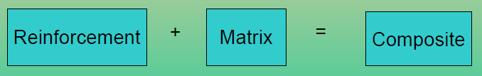
Composite Materials Definition
A materials system composed of two or more physically distinct phases whose combination produces aggregate properties that are different from those of its constituents.
Generally, one material forms a continuous matrix while the other provides the reinforcement.
Examples:
Concrete reinforced with steel
Epoxy reinforced with graphite fibers.
Plastic molding compounds containing fillers
Rubber mixed with carbon black

Slide 6
Composite Can Be Found In
The aerospace industry (structural components as well as engines and motors)
Automotive parts (panels, frames, dashboards, body repairs)
Sinks, bathtubs, hot tubs, swimming pools
Cement buildings, bridges
Surfboards, snowboards
Golf clubs, fishing poles, hockey sticks
Trees are technically composite materials, plywood
Electrical boxes, circuit boards, contacts and Everywhere

Slide 7
Why Composites are Important ?
Composites can be very strong and stiff, yet very light in weight, so ratios of strength‑to‑weight and stiffness‑to‑weight are several times greater than steel or aluminum
Fatigue properties are generally better than for common engineering metals
Toughness is often greater too
Composites can be designed that do not corrode like steel
Possible to achieve combinations of properties not attainable with metals, ceramics, or polymers alone

Slide 8
Advantages of composites:
These are more economical than metals and ceramics.
Weight of the composites is less than conventional metallic design.
Due to less weight, these are used in automobile industry to the larger extent for fuel economy(Fuel consumption is less).
Excellent mechanical and chemical properties.
More thermal resistance than conventional materials hence composites provide improved thermal insulation.
Corrosion resistance
Fabrication is very easy.
Good aesthetic appeal

Slide 9
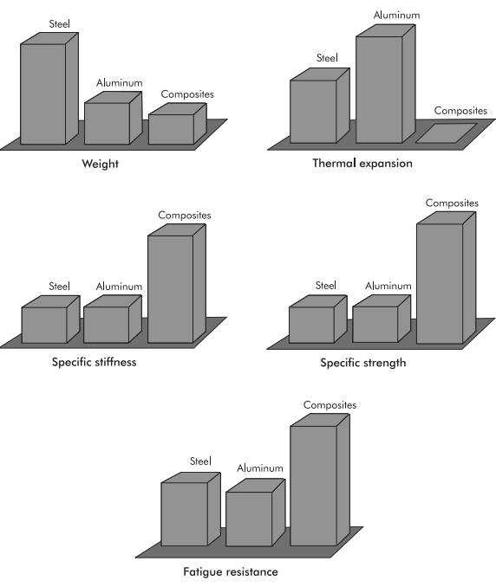

Slide 10
Disadvantages and Limitations of Composite Materials
Properties of many important composites are anisotropic ‑ the properties differ depending on the direction in which they are measured – this may be an advantage or a disadvantage
Many of the polymer‑based composites are subject to attack by chemicals or solvents, just as the polymers themselves are susceptible to attack
Manufacturing methods for shaping composite materials are often slow and costly

Slide 11
Uses:
Transportation industry- Racing vehicle components, engine components, racing boats etc.,
Aerospace rocket components, aircrafts.
Sporting goods ( lawn tennis rockets) and musical instruments
Industrial equipments: High speed machinery, PCB in which composite is an electrically insulating substrate on which electrical circuits are mounted.
Communication antennae

Slide 12
Composite Materials Definition
Definition: It may be defined as, composite materials are multi phase material that consists of two or more physically and or chemically distinct phases, and the properties of these materials are different from those of the individual materials of the composite.
The minimum number of constituents are two, they are
i) Matrix (Dispersion medium) - Into which other ingredients will be added ie., it holds all the ingredients.
ii) Reinforced material (Dispersed phase) - These are the substances added to dispersion medium(Matrix)

Slide 13
Functions of the Matrix Material (Dispersion medium)
It binds the dispersed phase & protect phases from environment
It acts as medium by which an externally applied load is transmitted and distributed to the dispersed phase or reinforcement
Holds the embedded phase in place, usually enclosing and often concealing it
When a load is applied, the matrix shares the load with the secondary phase, in some cases deforming so that the stress is essentially born by the reinforcing agent
It protects the individual fibres from chemical reaction with environment.

Slide 14
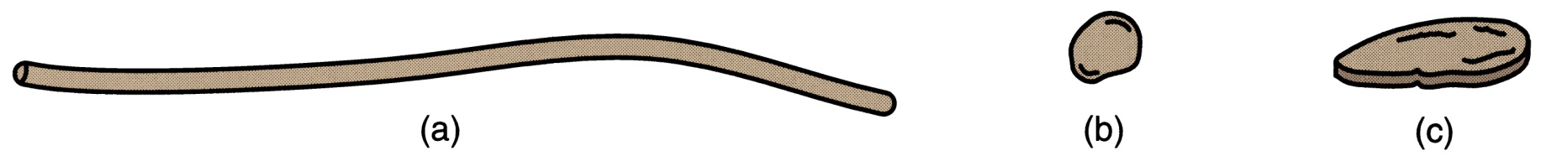
Reinforcing agents
Function is to reinforce the matrix.
1. Contribute desired properties
2. Load carrying
3. Transfer the strength to matrix
Shape of Reinforcements
Reinforcing agents are most commonly one of the following shapes:
Fibers (a);
Particles (b);
Flakes (c)
Textile materials, sheet of paper, folios.

Slide 15
Constituents of the Composite Materials
Materials for Fibers
Fiber materials in fiber‑reinforced composites:
Glass – most widely used filament;
Carbon – high elastic modulus;
Boron – very high elastic modulus;
Polymers – Kevlar;
Ceramics – SiC and Al2O3
Metals – steel.
The most important commercial use of fibers is in polymer composites.

Slide 16
Constituents of the Composite Materials
Particles and Flakes
A second common shape of imbedded phase are particles , ranging in size from microscopic to macroscopic.
Flakes are basically two‑dimensional particles ‑ small flat platelets
The distribution of particles in the composite matrix is random, and therefore strength and other properties of the composite material are usually isotropic.
Strengthening mechanism depends on particle size.

Slide 17
One Possible Classification of Composite Materials
Traditional composites – composite materials that occur in nature or have been produced by civilizations for many years
Examples: wood, concrete, asphalt
Synthetic composites - modern material systems normally associated with the manufacturing industries, in which the components are first produced separately and then combined in a controlled way to achieve the desired structure, properties, and part geometry

Slide 18
Classification:
Composites are classified into different types based on dispersion medium (matrix) and dispersed phases.
Based on matrix ( dispersion medium) –
composites are classifies into three types. They are
i) Polymer based composites (PMC) :in which polymer is the matrix to which other substances added.
ii) Metal based composites (MMC): in which metal is the matrix to which other substances are added.
iii) Ceramics based composites (CMC): in which Ceramic is the matrix to which other substances are added.
.

Slide 19
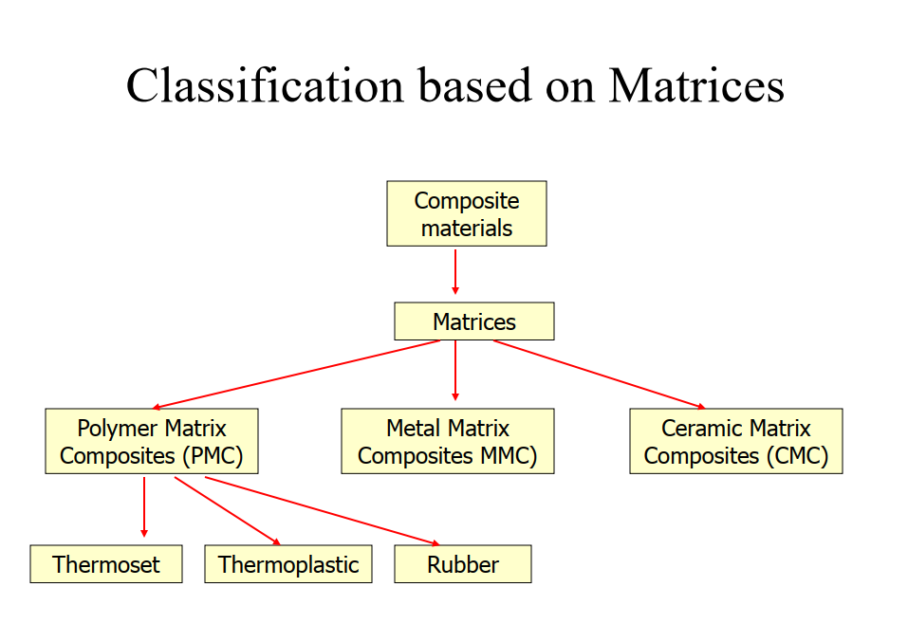

Slide 20
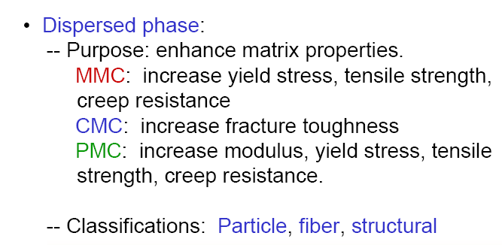

Slide 21
Based on reinforcement (dispersed phase) composites are three types: They are,
i) Fibre reinforced composites-Further classified into types they are short and long fibre composites
ii) Particle based composites – Again further classified into large particle based composites and dispersion strengthened composites.
iii) Layered composites- Further classified into unilayer and multilayer composites
Functions of reinforcement materials:
Can provide the required the properties. Orientation, concentration of these materials etc., will decide the properties.

Slide 22
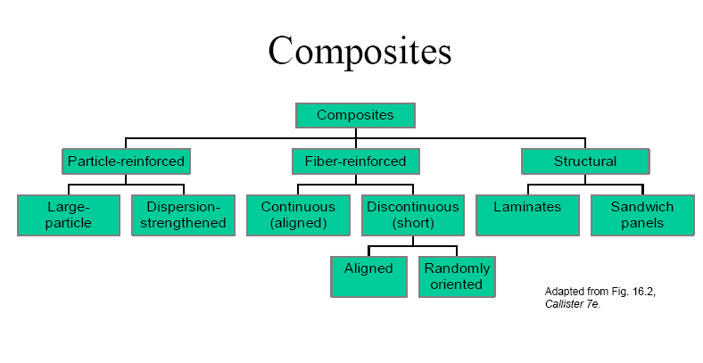

Slide 23
Primary Phase, Matrix
Secondary Phase,
Reinforcement

Slide 24
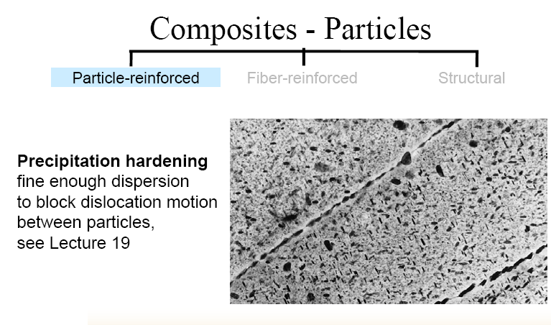
Reinforcing Phase (Secondary)

Slide 25
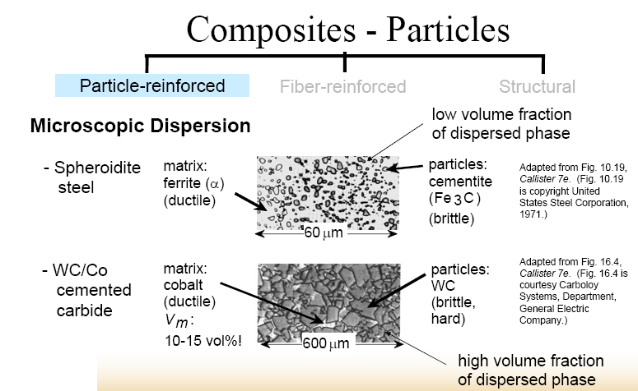

Slide 26
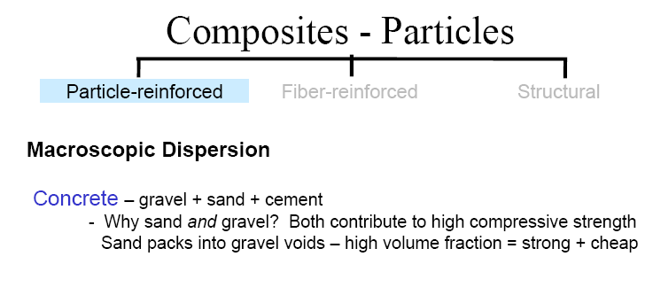

Slide 27
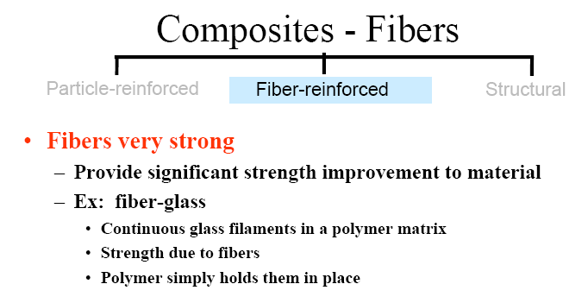

Slide 28
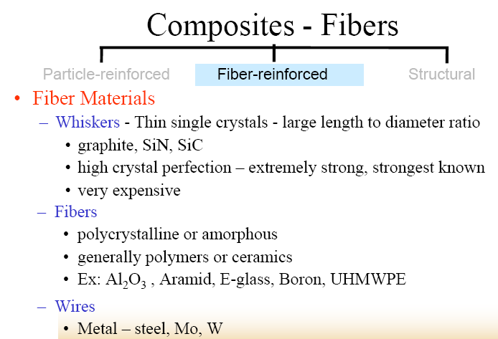

Slide 29
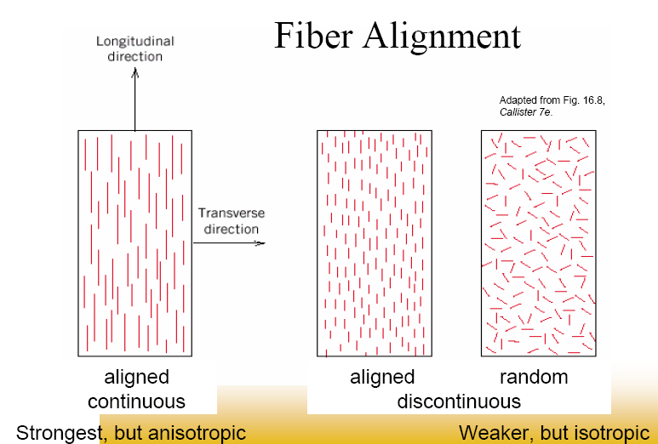

Slide 30
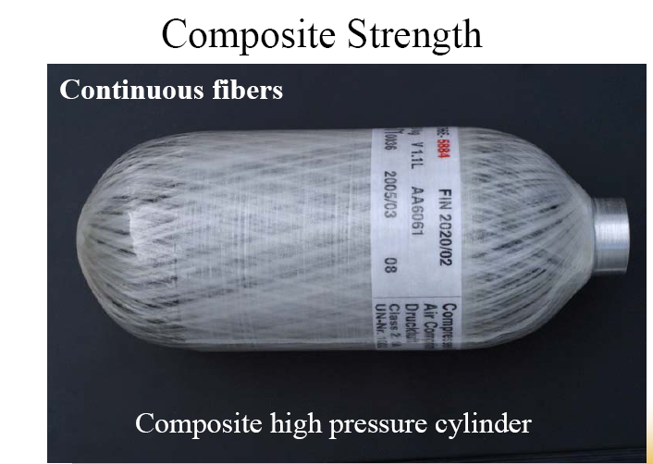

Slide 31
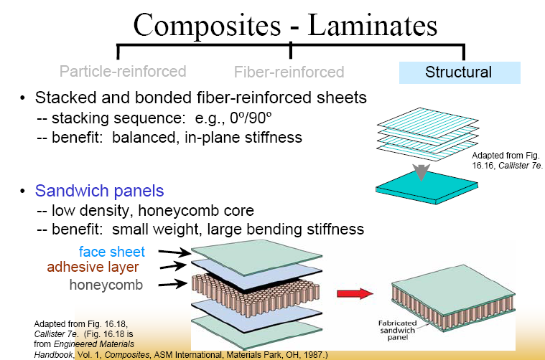

Slide 32
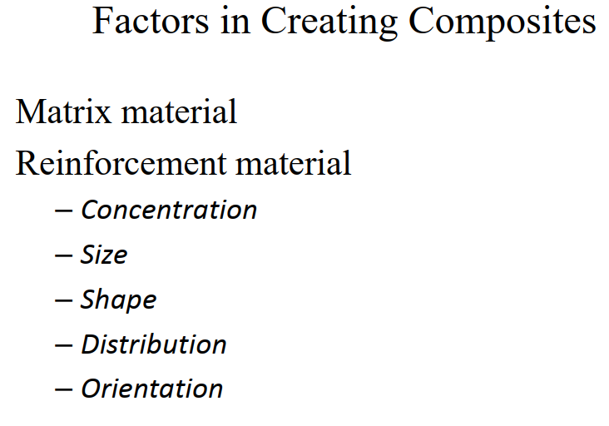

Slide 33
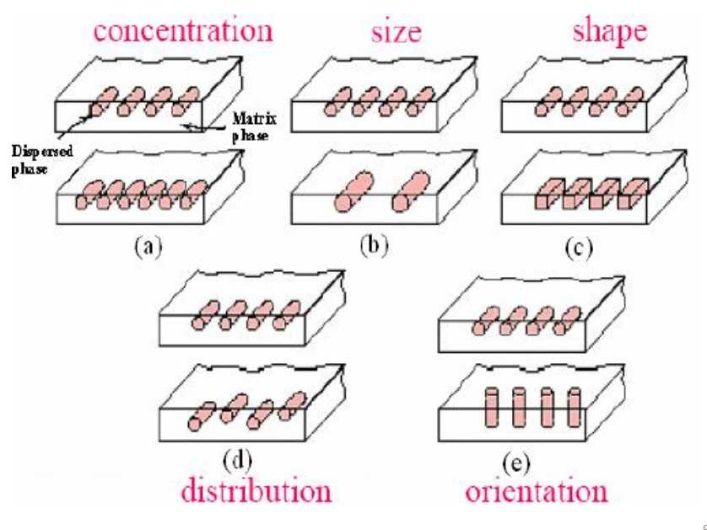

Slide 34
Manufacturing methods
Composites can be prepared by two methods; they are open and closed moulding methods.
Hand Lay-up technique is one of the open moulding methods.
The processing steps are quite simple.
The required materials are
1) Matrix 2) Resin 3) Release gel 4) Hardner and 5) Reinforcing material
Matrix like Epoxy, polyester, polyvinyl ester, phenolic resin, unsaturated polyester, polyurethane resin are used.
Reinforcement like Glass fibre, carbon fibre, aramid fibre, natural plant fibres (sisal, banana, nettle, hemp, flax etc.) are used.

Slide 35
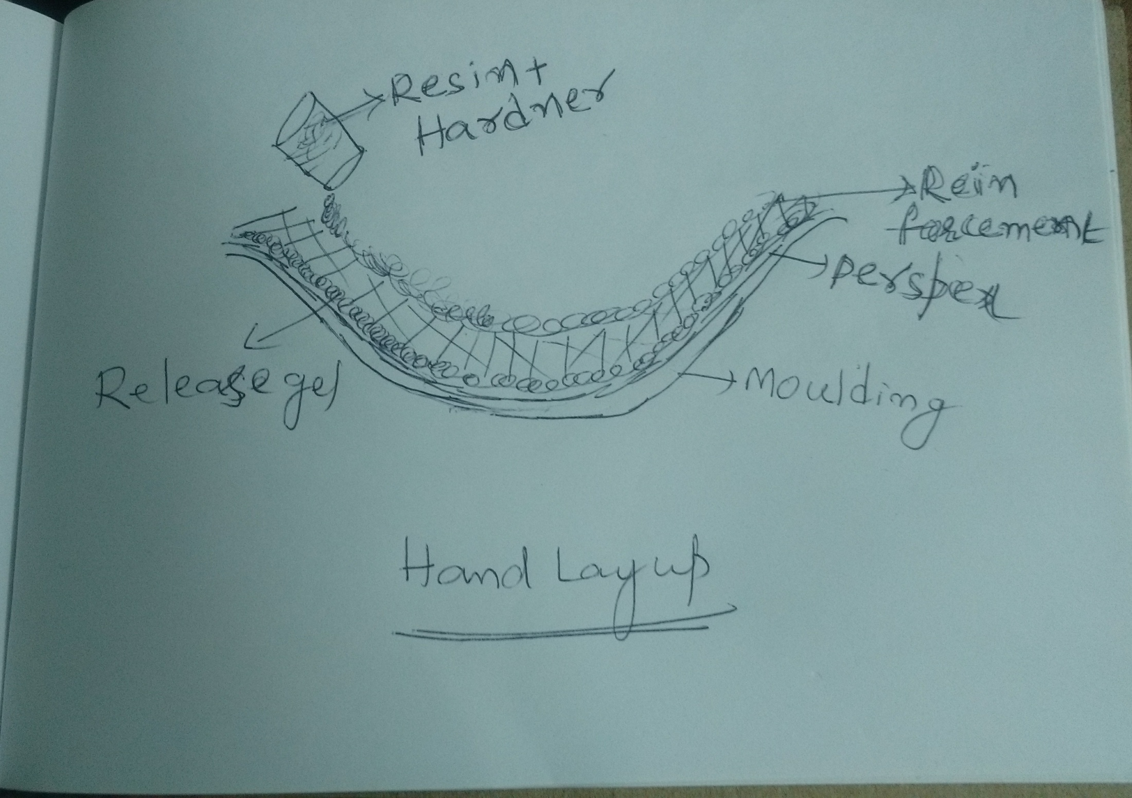

Slide 36
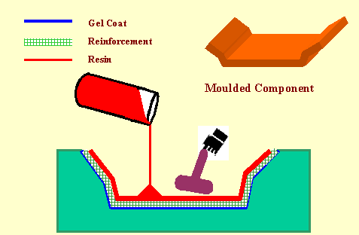
Hand Lay-up technique
Gel + Perspex sheet
Resin + Hardener (curing agent)

Slide 37
Steps involved in the process:
i)Release gel is sprayed on the mould surface to avoid the sticking of polymer to the surface. Thin plastic sheets are used at the top and bottom of the mould plate to get good surface finish of the product.
ii) Reinforcement in the form of woven mats or chopped strand mats is cut as per the mould size and placed at the surface of mould after perspex sheet.
iii) Then thermosetting polymer in liquid form is mixed thoroughly in suitable proportion with a prescribed hardner (curing agent) and poured onto the surface of mat already placed in the mould. The polymer is uniformly spread with the help of brush.

Slide 38
iv) After curing either at room temperature or at some specific temperature, mould is opened and the developed composite part is taken out and further processed. The time of curing depends on type of polymer used for composite processing
Advantages: i)Production rate is less, simple and inexpensive
ii) Capital and infrastructural requirement is less. iii) Normal temperature and less time is required for curing than other methods.
Limitations: Can be used to make smaller structures only Complex structures can’t be moulded.
Mass production can’t be taken place
Applications: Areas like aircraft components, automotive parts, boat hulls, dais board, deck etc.

Slide 39
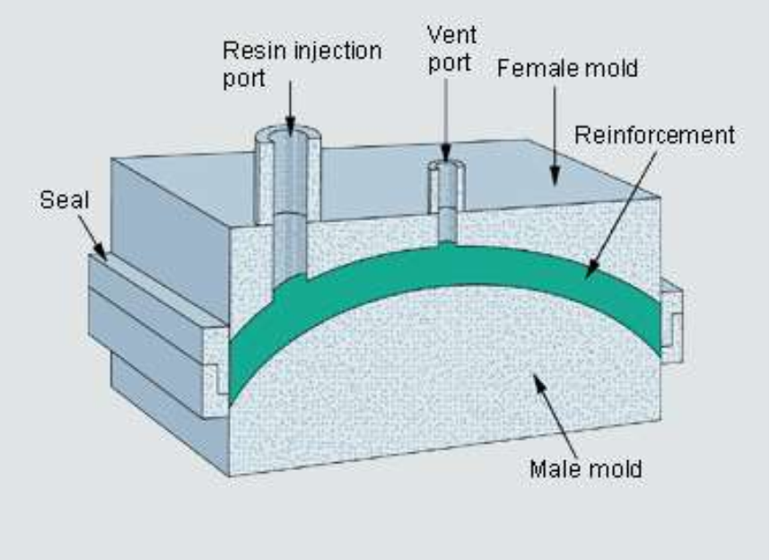
RESIN TRANSFER METHOD(RTM)
It is one of the closed moulding methods; resin is not in direct contact with the air.
Resin transfer moulding is also known as liquid transfer moulding process.

Slide 40
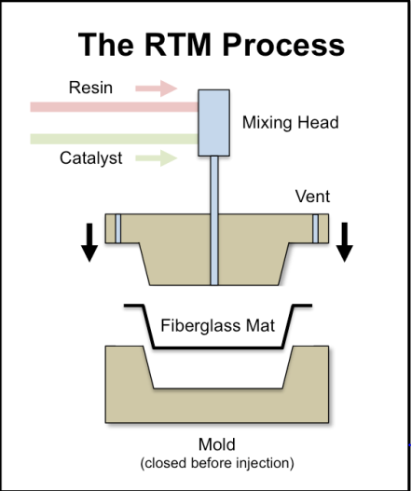
Reinforcement used in RTM
Type
E-glass
S-glass
Carbon/graphite
Aramid
Preforms
pre-shaping of reinforcement
Resins:
Polyester, vinyl ester, epoxy
Additives
Filler
Hardener

Slide 41
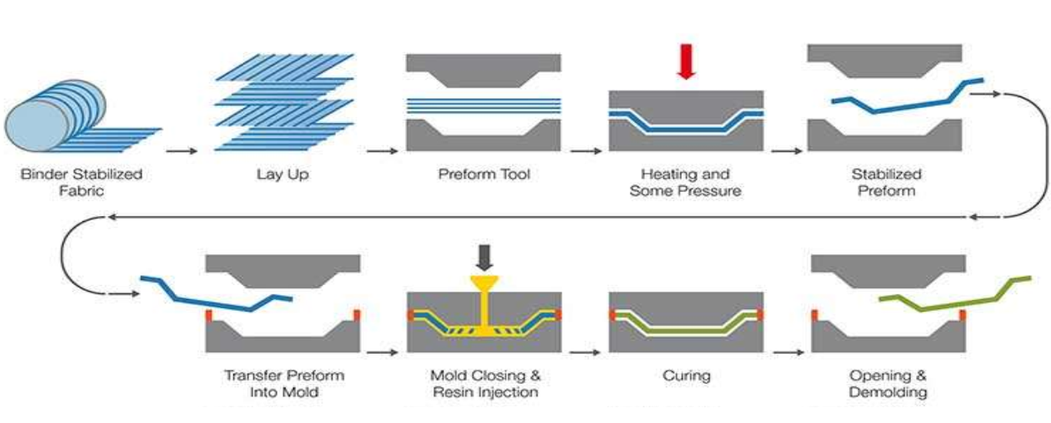
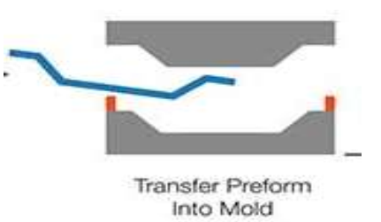
Five steps are involved in the process:
Creating preform: Reinforced material is made into required shape. Generally glass fibre is used as reinforced material.
Preform layup : The preformed shape should be placed in moulding cavity that has the shape of the desired product.

Slide 42
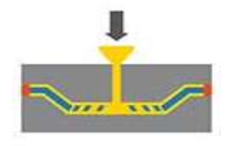
Moulding: Before placing preform the moulding cavity is coated with release gel which does not allow sticking to the moulding cavity. The moulding cavity is provided with inlet and out let. Preform is placed in cavity and closed with clamps. The entrapped air is sent out through outlet using evacuated pump.
Catalyze phase: Allow the low viscosity resin slowly along with additives till the cavity filled. Under the influence of additives the resin will undergo polymerisation and forms composite material.

Slide 43
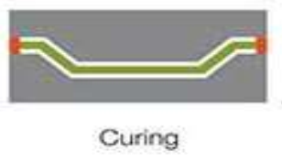
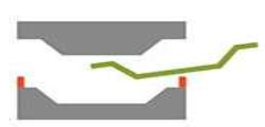
Curing phase: During this time resin undergoes polymerisation and forms a solid composite material. Depending on the resin 24 to 48 hours required for solidification.
Curing
After curing the composite part is removed from the mold.

Slide 44
Schematic diagram of complete RTM process

Slide 45
Precautions: The size of the moulding cavity should be equal to thickness of the final product.
Advantages:
Labour cost is minimum
Good surface area
Large and complex shapes can be moulded
Low capital investment
Wide range of resins can be used.
Limitations:
i) Large thickness composites cant be made.
ii) Glass fibre reinforced material cant be stable at extreme high temperatures.

Slide 46
Pultrusion method
-It is one of the closed molding methods.
Two types of pultrusion process
i) Ordinary pultrusion process can be provided a straight chain composites materials
ii) Radius pultrusion technique can provide 2D and 3D curved composites.
Advantage: continuous constant cross section shapes of any length can be manufactured with low cost

Slide 47
The following steps are involved in the process,
i) As per the thickness of desired product, the reinforced material allow in the form of fibre through rollers. Generally carbon fibre and glass fibre reinforcement are used.
ii) The reinforced material is allowed to pass through resin impregnator where fibre can be soaked in resin. Generally polyethylene terepththalate and tri butyl phthalate etc. are used as resin.
iii) The fibre is coated with resin and allows passing through heat source where resin undergoes polymerisation and solidification.

Slide 48
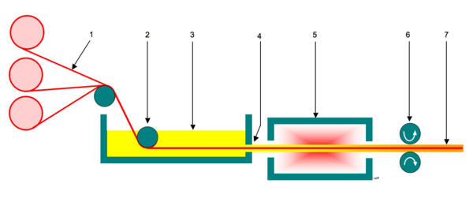
iv) The solid composite pulled through pulling mechanism which provides uniform thickness of composites.
v) The uniform thickness of composite is subjected to final product as the desired shape and size.
The schematic diagram
1 – Continuous roll of reinforced fibres/woven fibre mat 2 – Tension roller 3 – Resin Impregnator 4 – Resin soaked fibre 5 – Die and heat source 6 – Pull mechanism 7 – Finished hardened fibre reinforced polymer

Slide 49
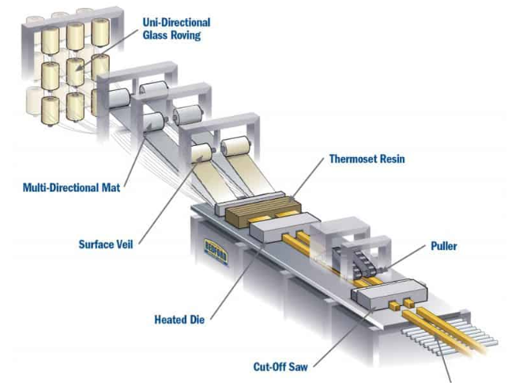

Slide 50
Applications: -
Used in agriculture and chemical industries.
In construction industry for the, PVC windows etc.,
Used in aero –space industry as various components of aircraft.
Used in automobile industry for the production of complex parts of the vehicles with enhance stiffness, rigidity and light weight, production of car cases etc.,

Slide 51
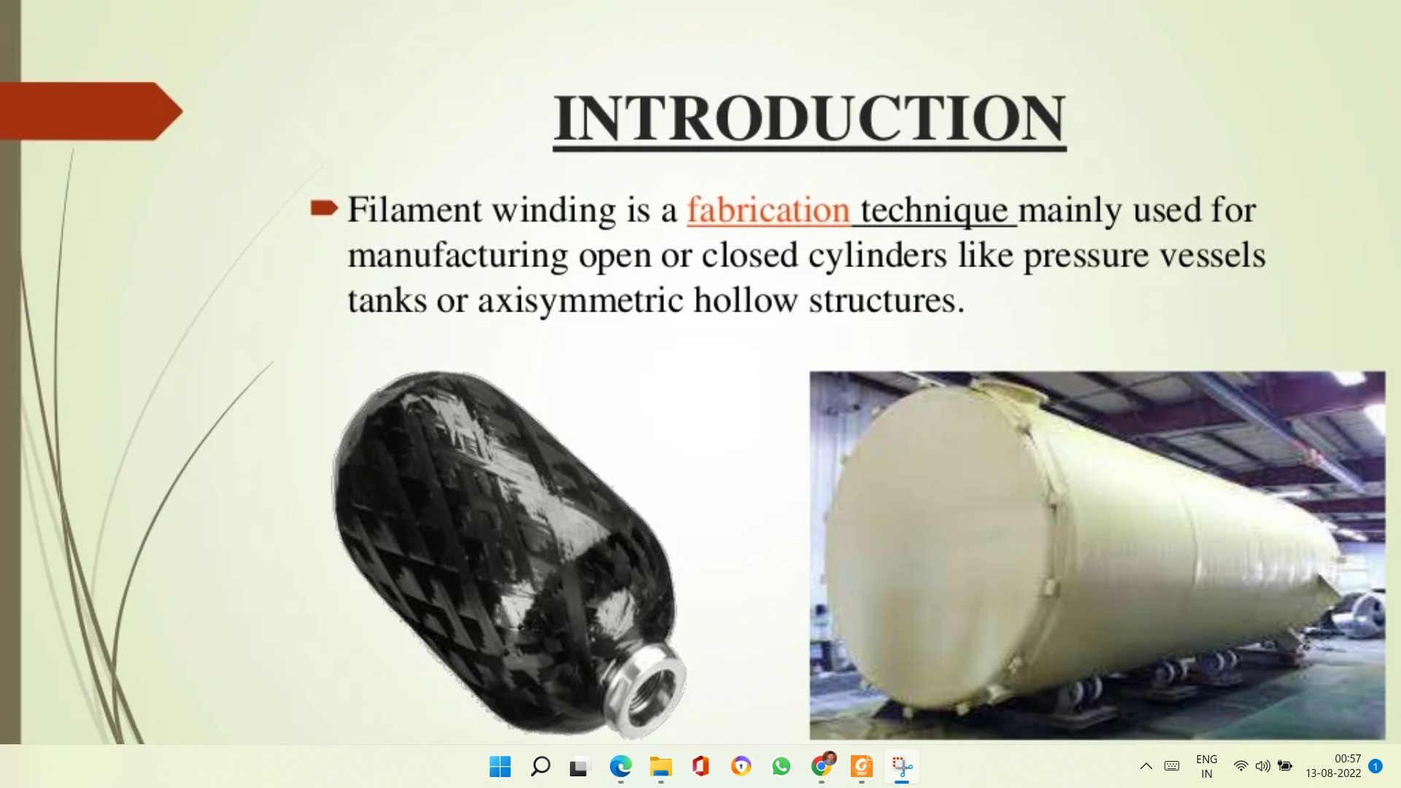
FILAMENT WINDING

Slide 52
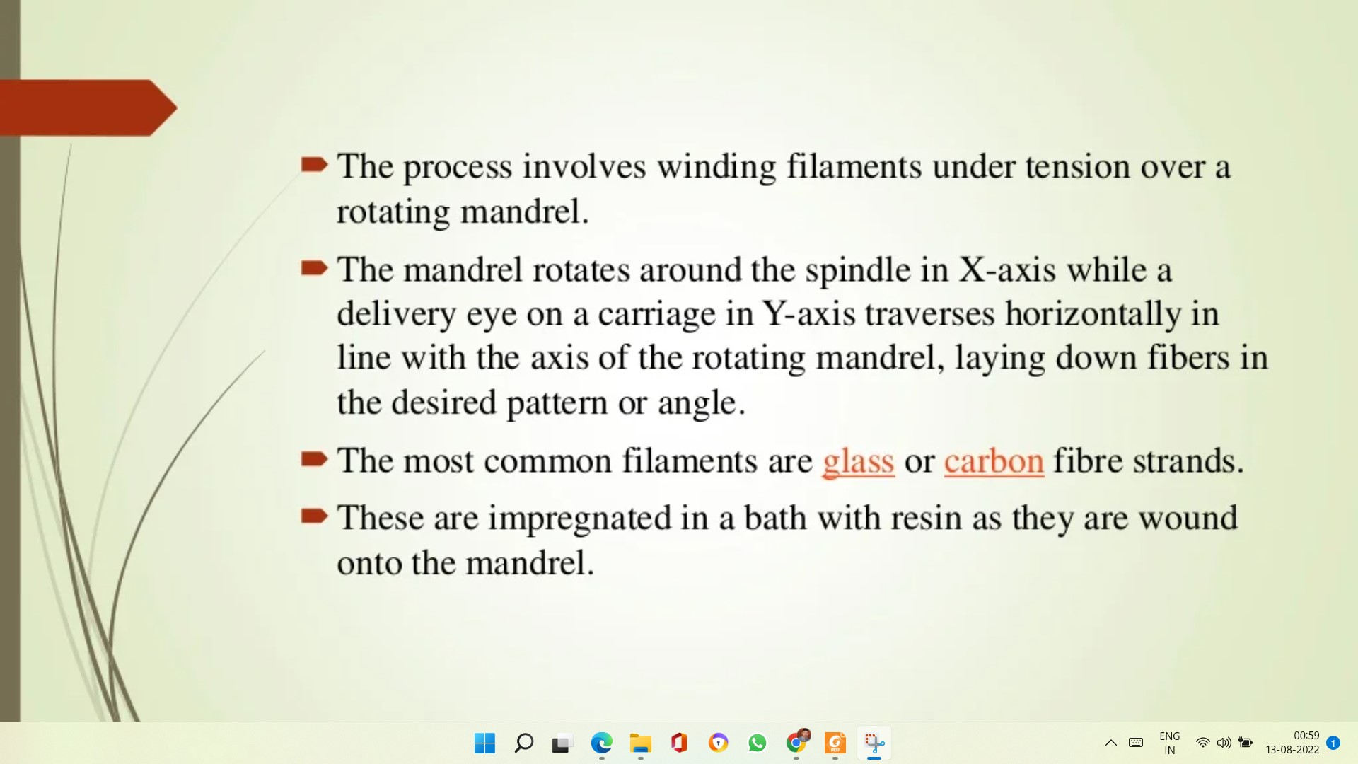

Slide 53
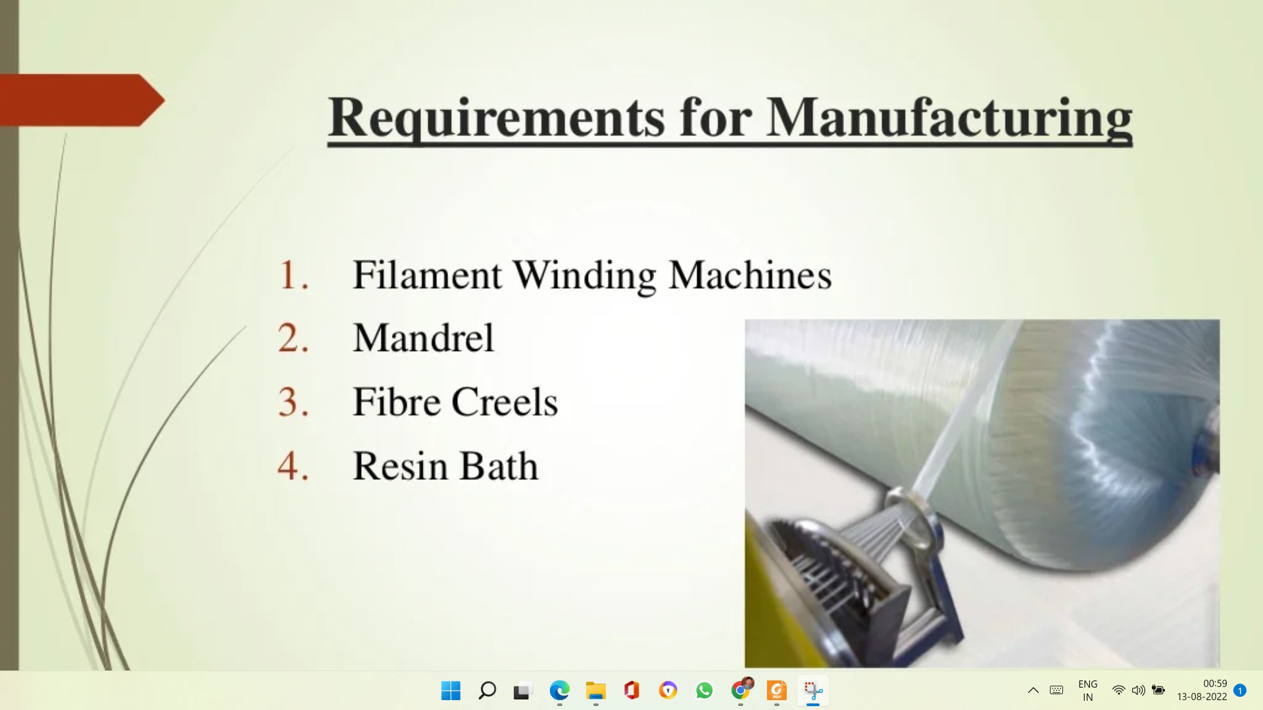

Slide 54
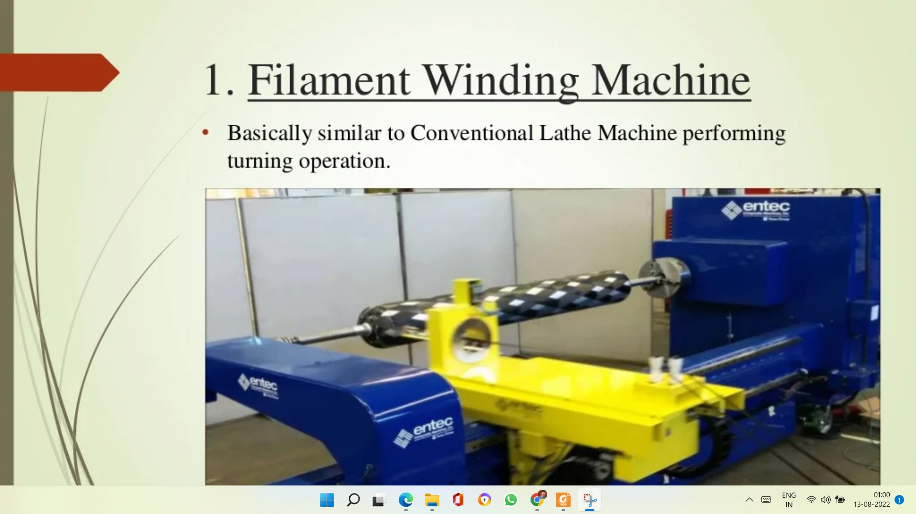
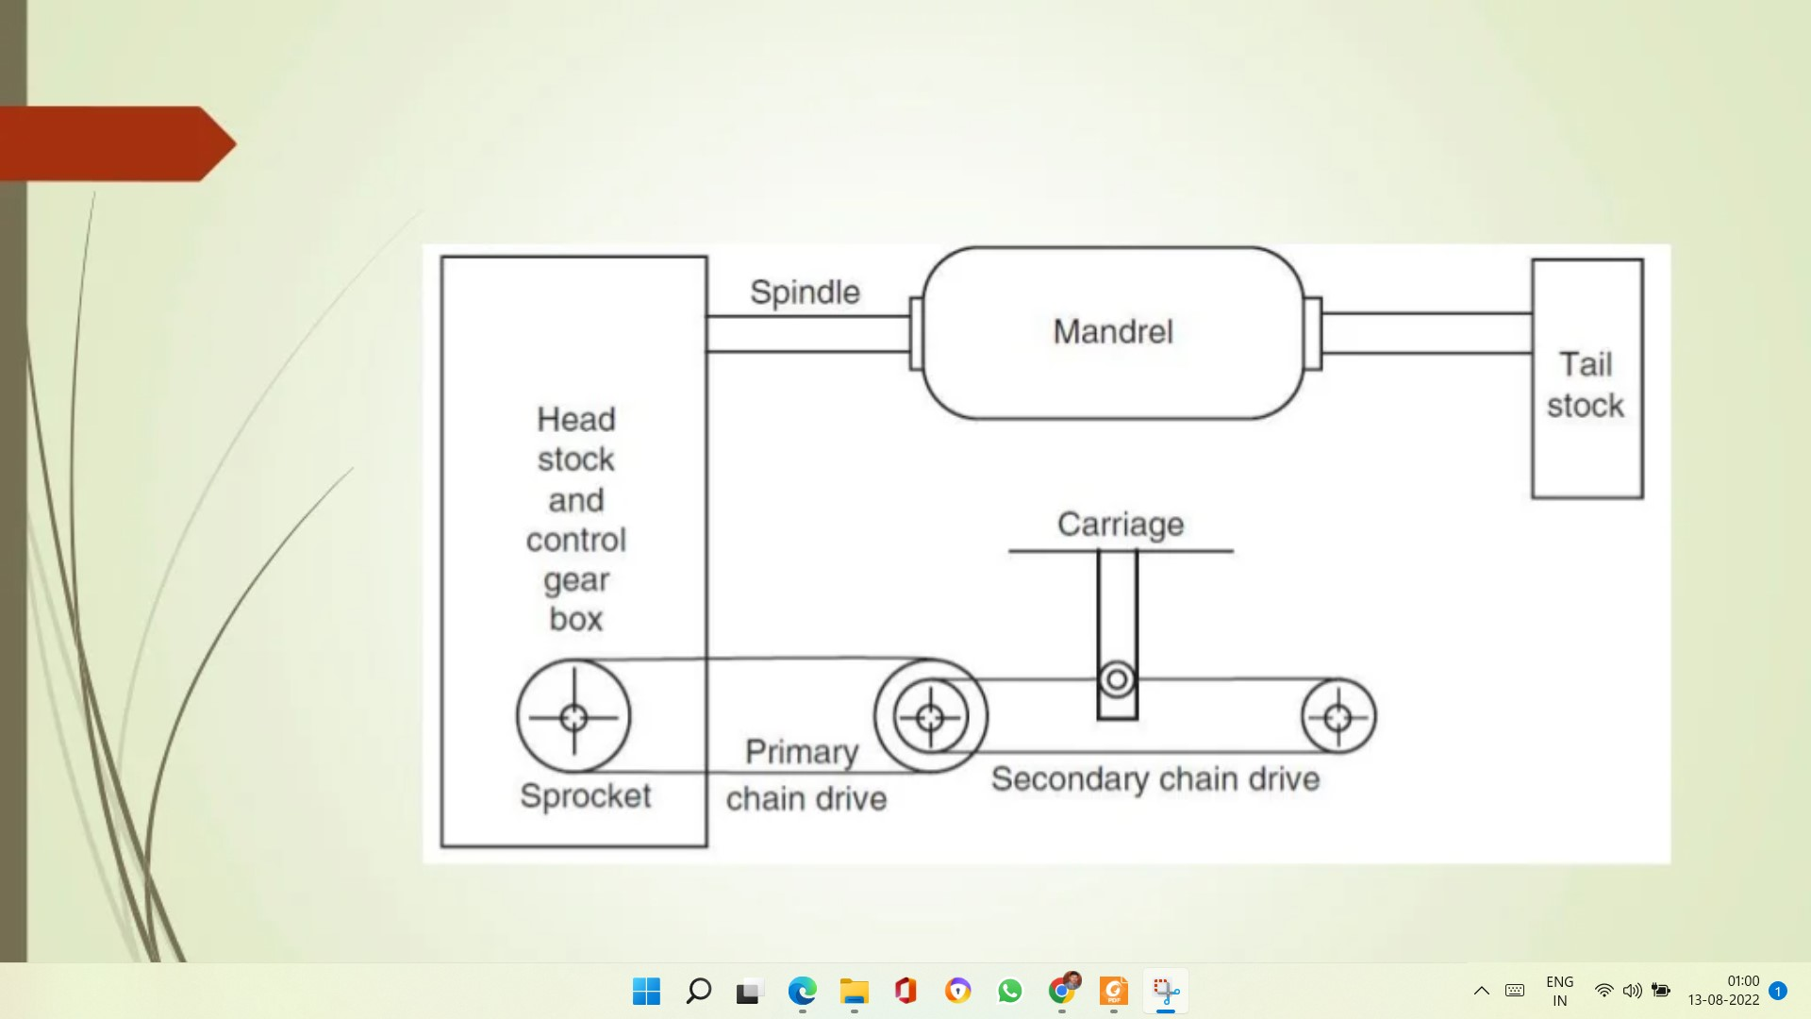

Slide 55
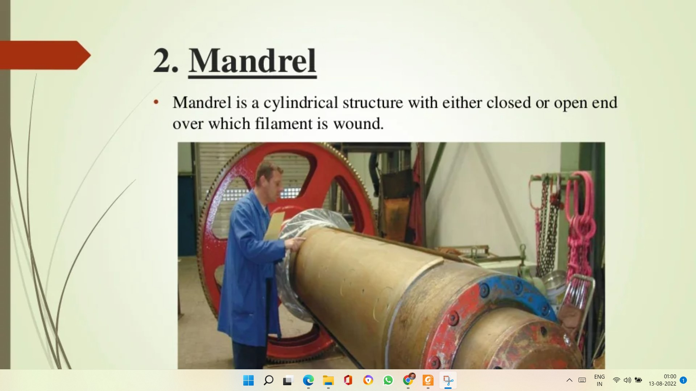

Slide 56
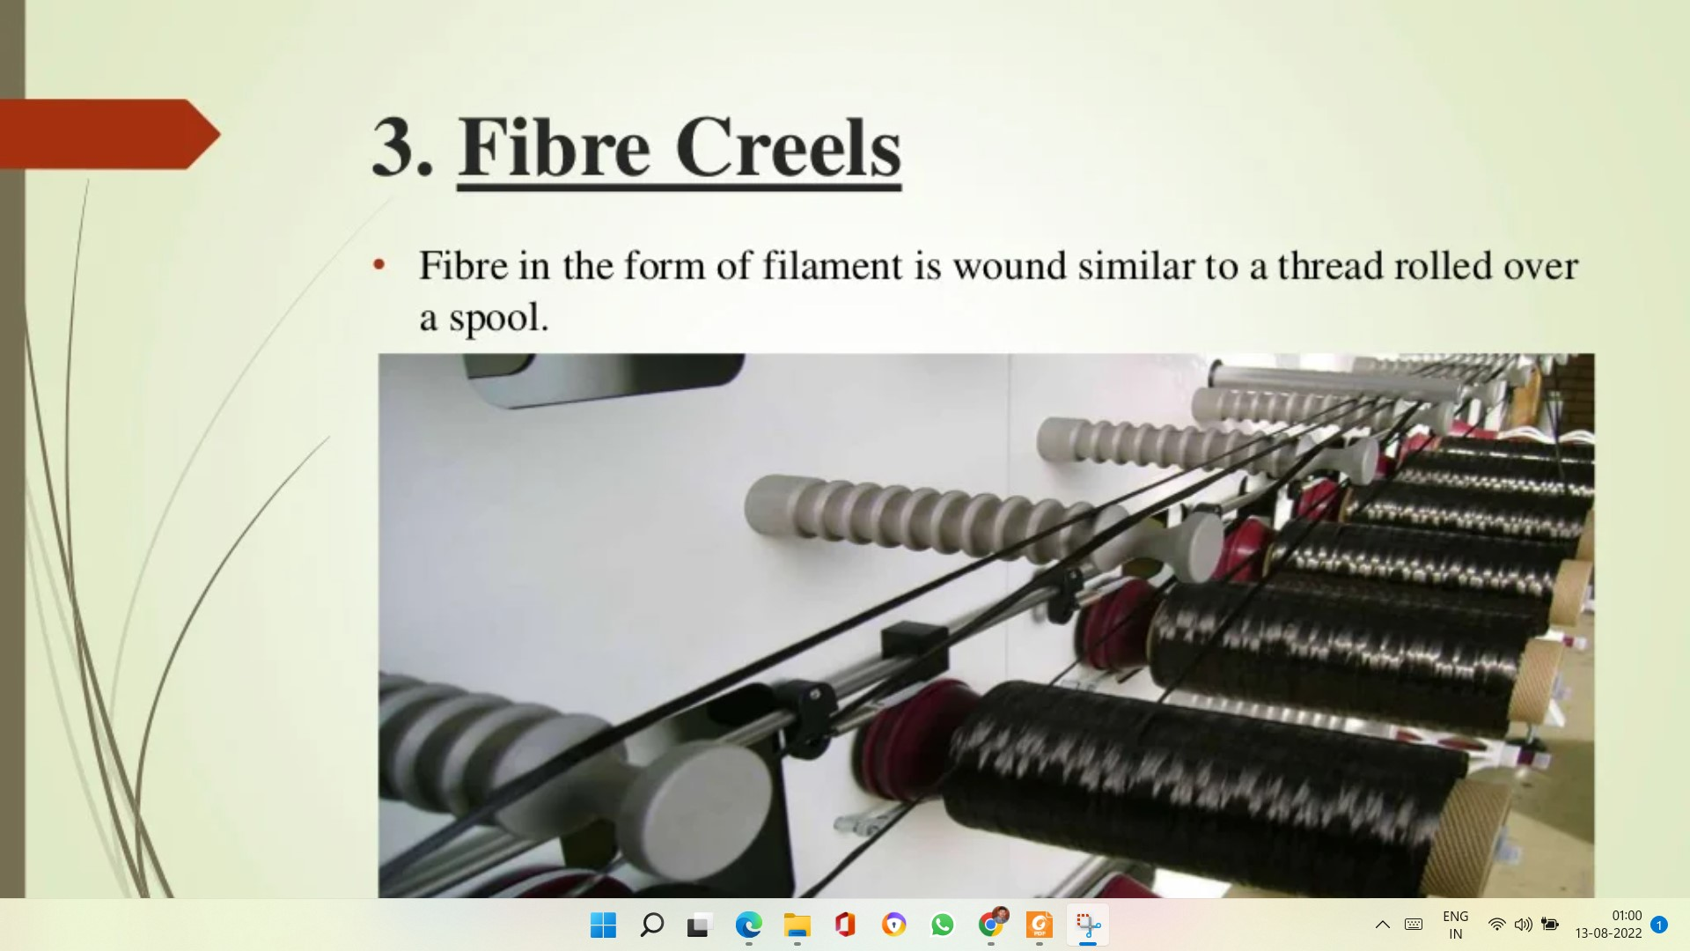

Slide 57
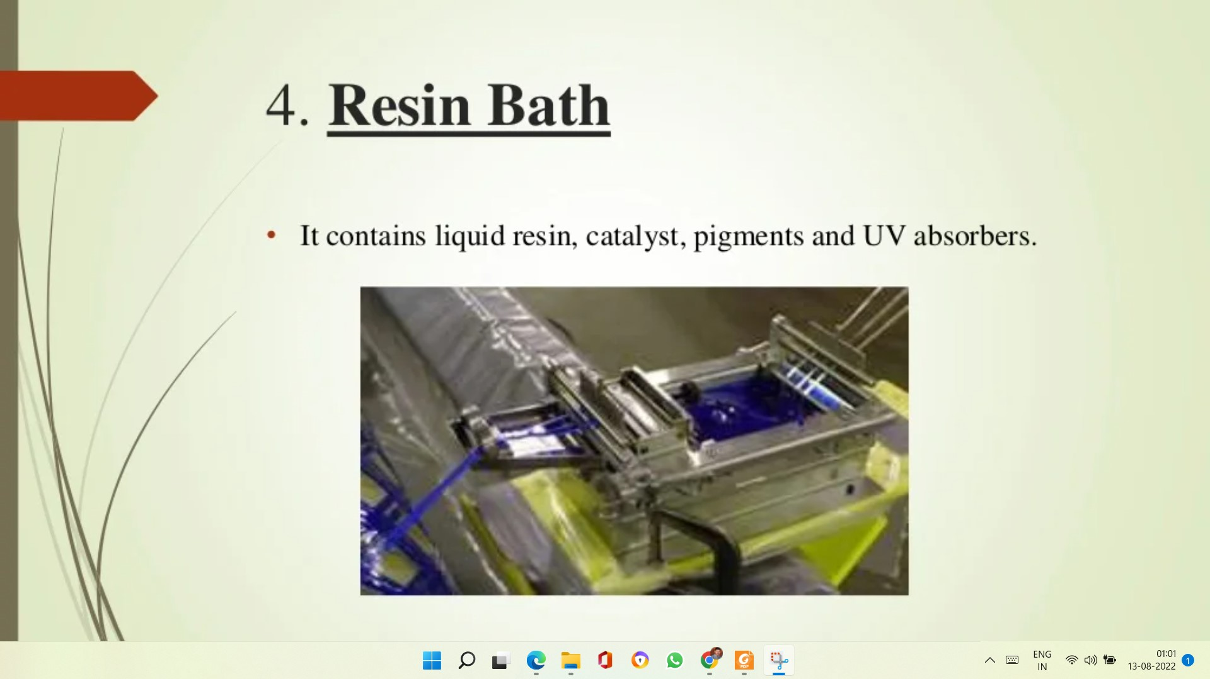

Slide 58
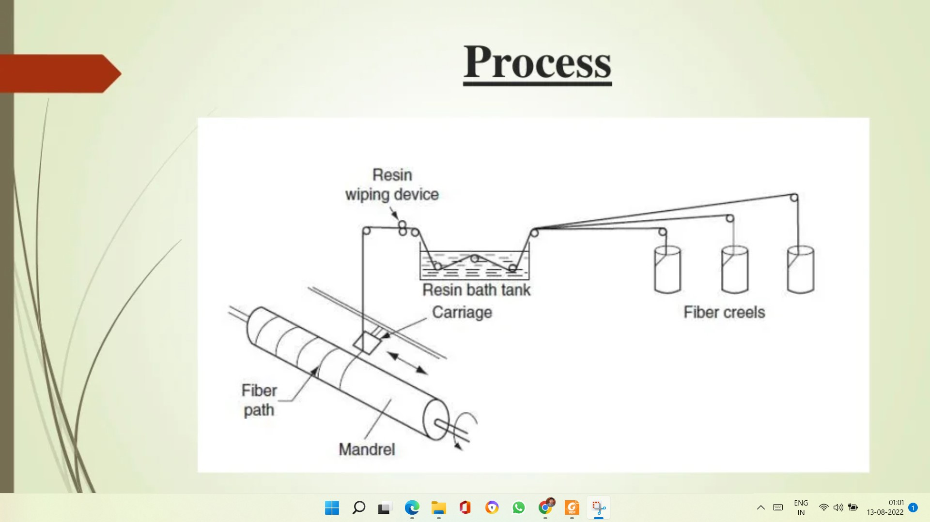

Slide 59
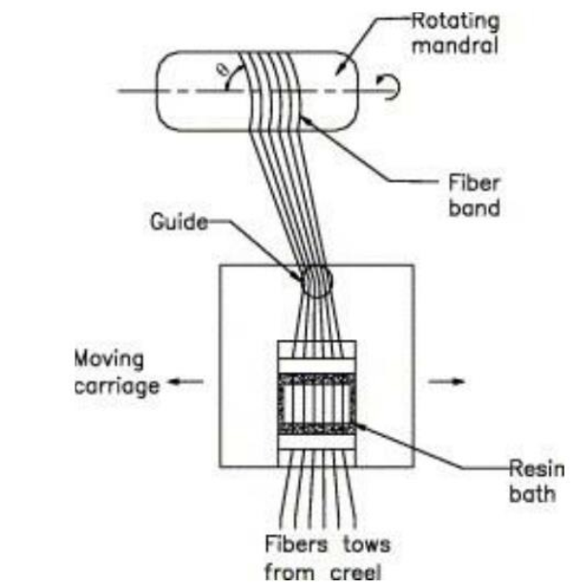

Slide 60
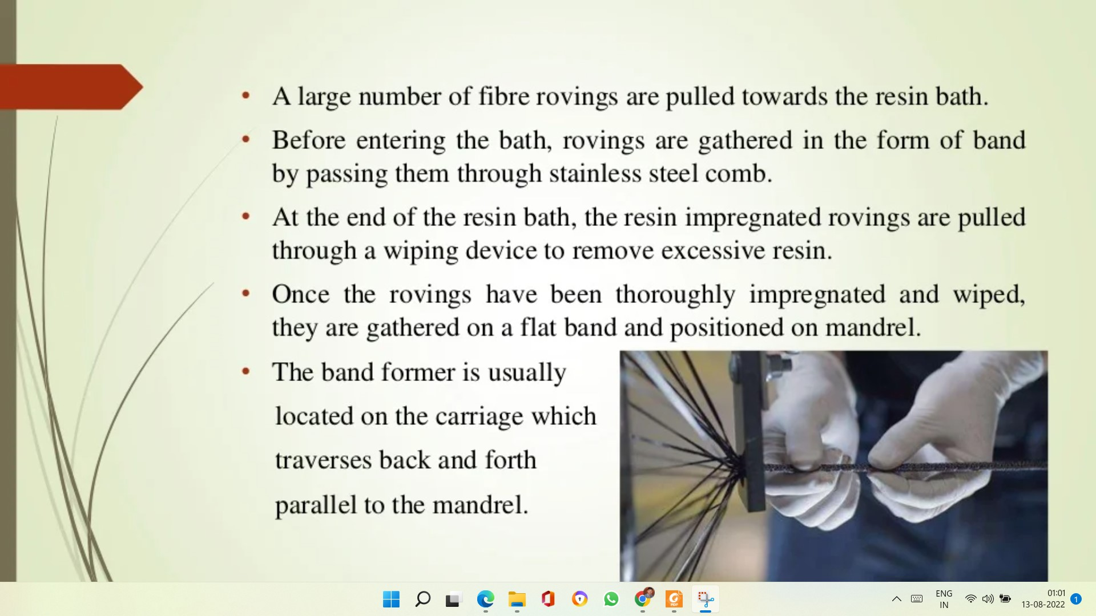

Slide 61
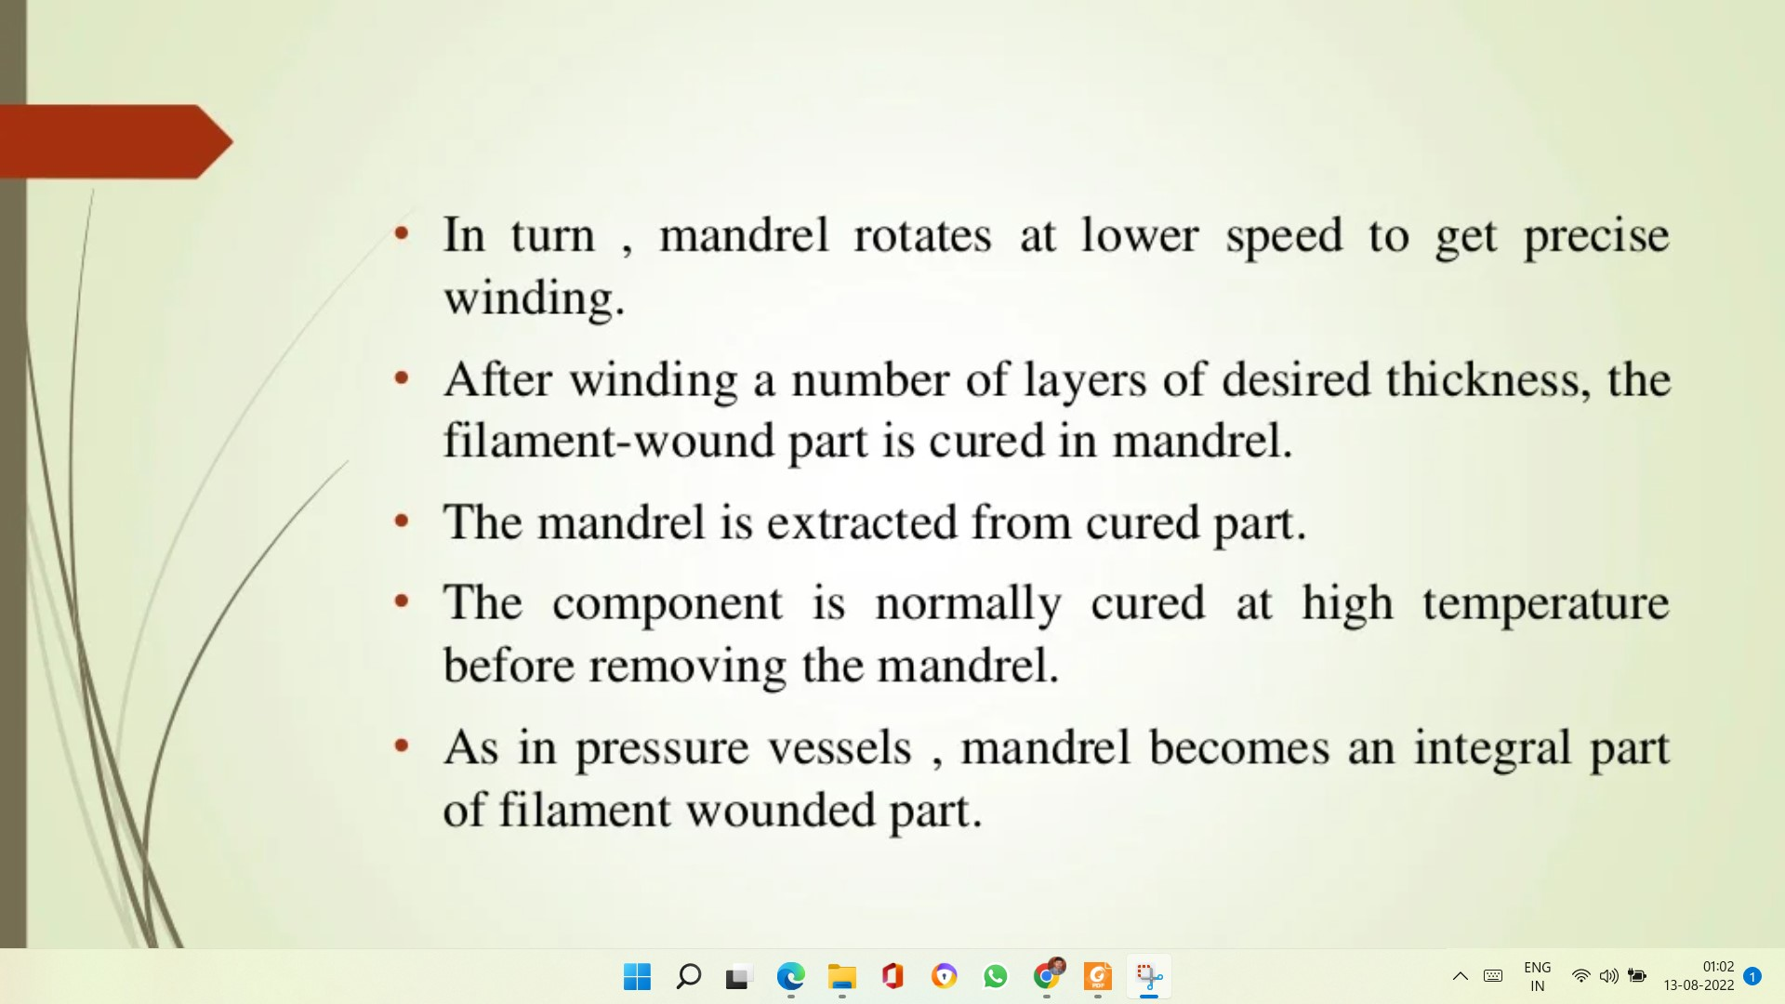

Slide 62
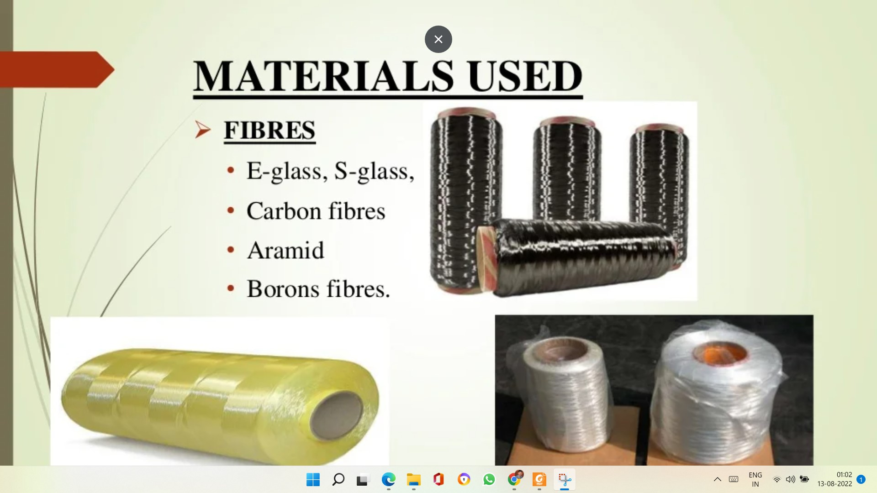
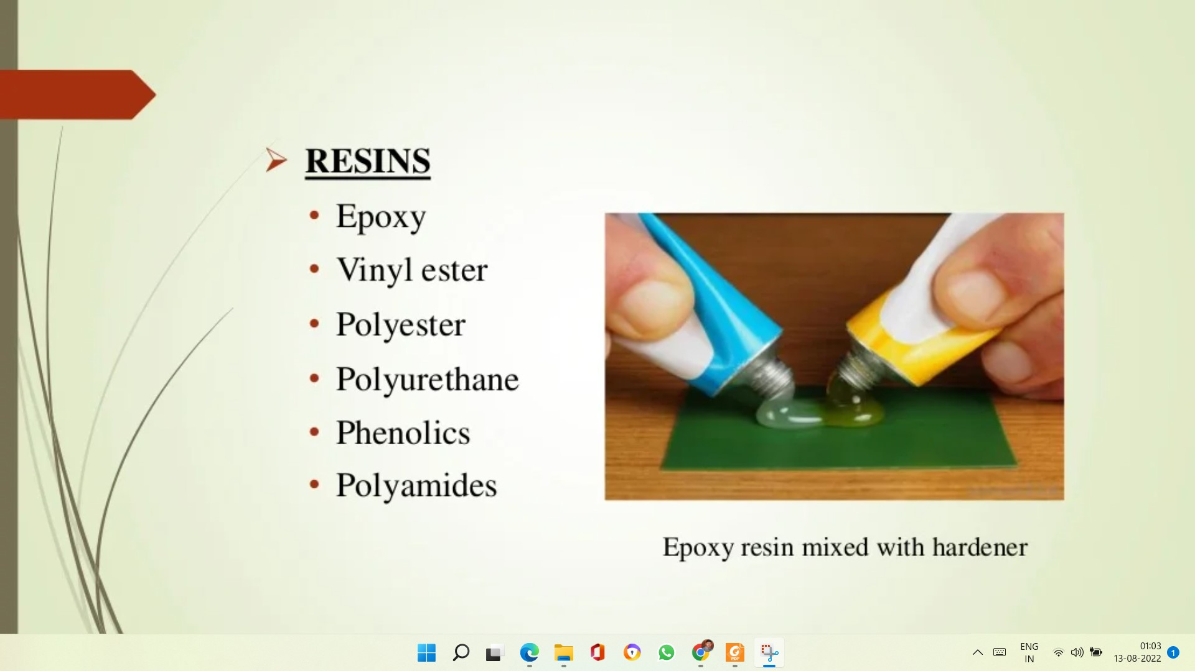
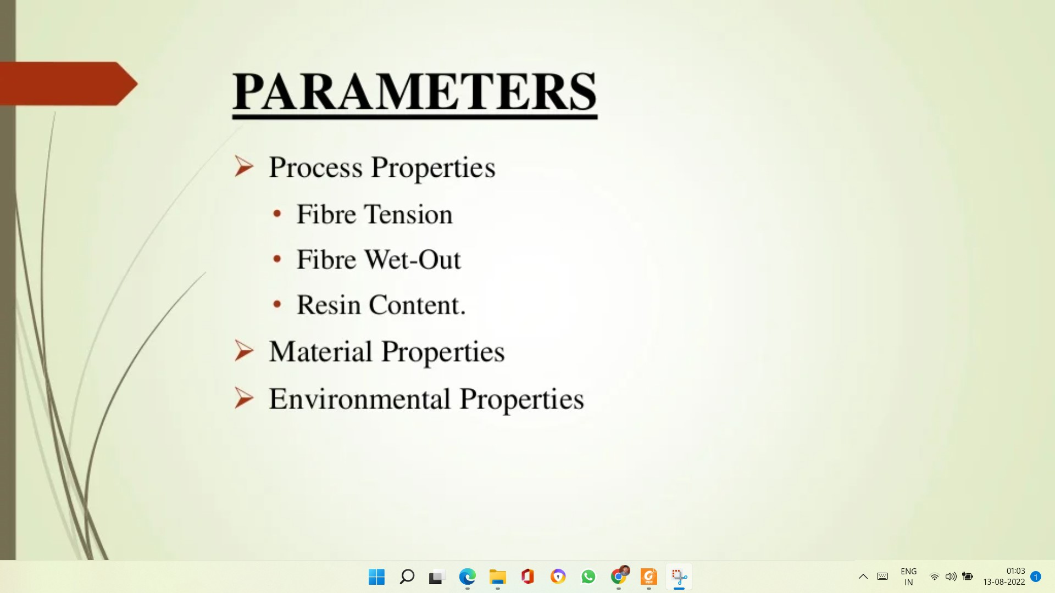

Slide 63
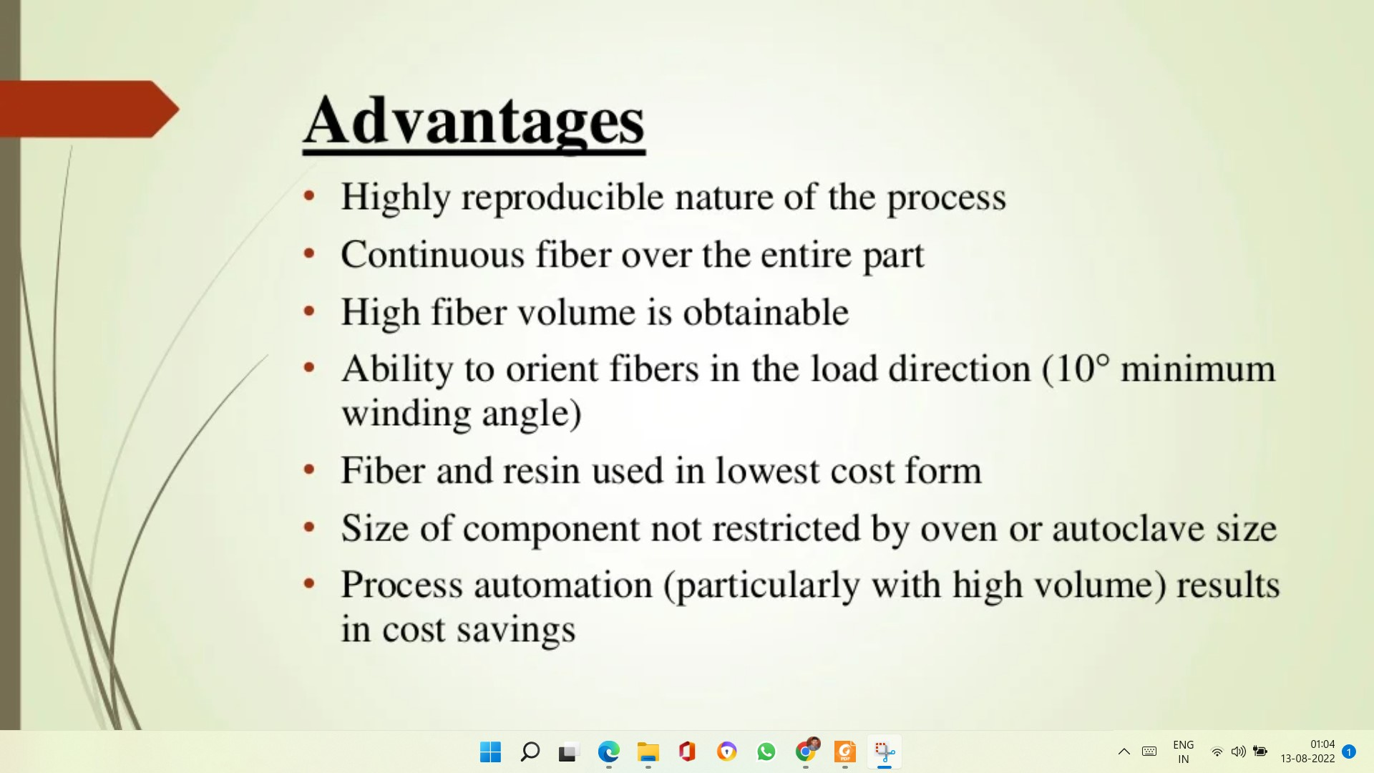

Slide 64
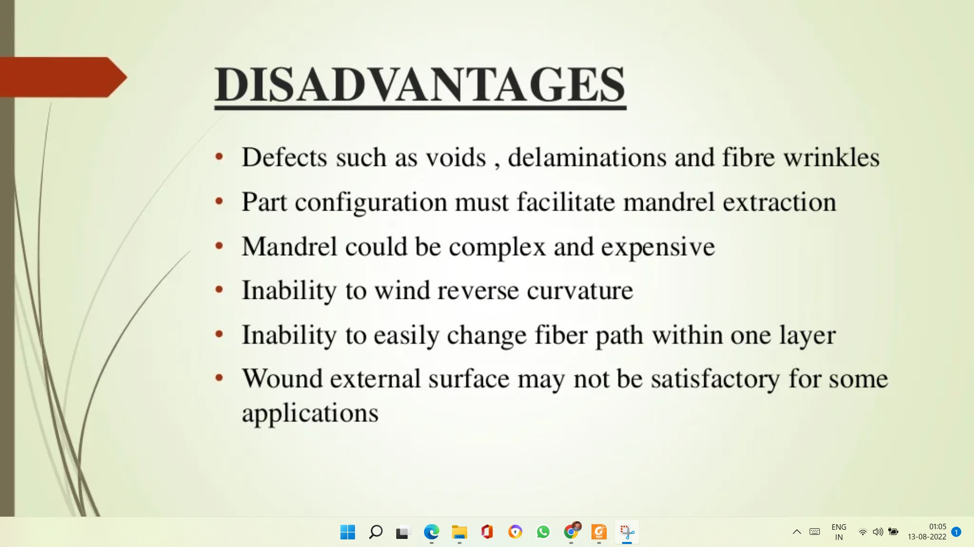

Slide 65
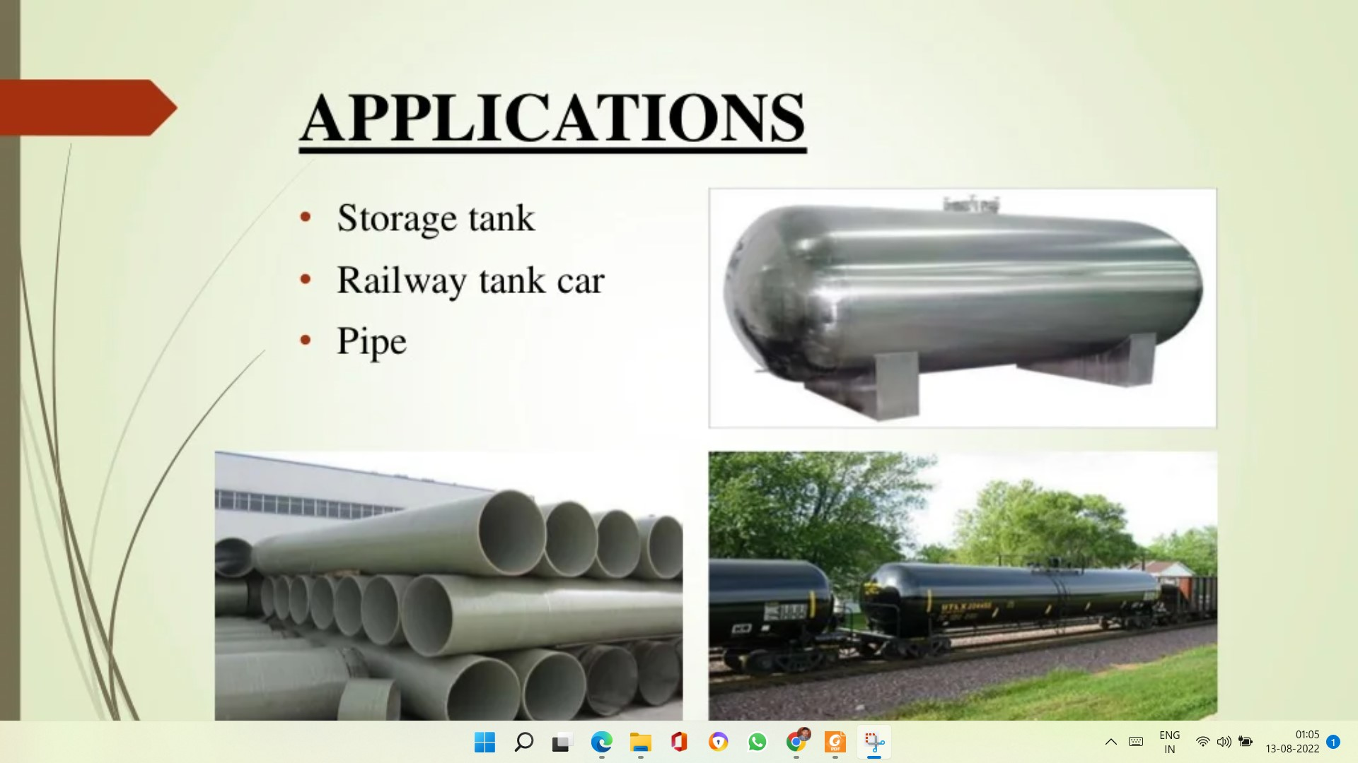

Slide 66
Fibers
Filaments of reinforcing material, usually circular in cross‑section
Diameters range from less than 0.0025 mm to about 0.13 mm, depending on material
Filaments provide greatest opportunity for strength enhancement of composites
The filament form of most materials is significantly stronger than the bulk form
As diameter is reduced, the material becomes oriented in the fiber axis direction and probability of defects in the structure decreases significantly

Slide 67
Continuous vs. Discontinuous Fibers
Continuous fibers - very long; in theory, they offer a continuous path by which a load can be carried by the composite part
Discontinuous fibers (chopped sections of continuous fibers) - short lengths (L/D = roughly 100)
Important type of discontinuous fiber are whiskers ‑ hair-like single crystals with diameters down to about 0.001 mm (0.00004 in.) with very high strength

Slide 68
Materials for Fibers
Fiber materials in fiber‑reinforced composites:
Glass – most widely used filament
Carbon – high elastic modulus
Boron – very high elastic modulus
Polymers - Kevlar
Ceramics – SiC and Al2O3
Metals - steel
The most important commercial use of fibers is in polymer composites

Slide 69
Fiber‑Reinforced composites
-Fiber reinforced composites provide improved strength, fatigue resistance, Young’s modulus and strength to weight ratio over the constituent materials.
-This is achieved by incorporating strong, stiff, yet brittle fibers into a more ductile matrix.
-Generally speaking the fiber supplies the strength and stiffness while the matrix binds the fibers together and provides a means of transferring the load between fibers
-The matrix also provides protection for the fibers

Slide 70
Common Fiber Reinforced Polymer Structure
Most widely used form of FRP is a laminar structure, made by stacking and bonding thin layers of fiber and polymer until desired thickness is obtained
By varying fiber orientation among layers, a specified level of anisotropy (direction dependence of the physical properties) in properties can be achieved in the laminate
Applications: parts of thin cross‑section, such as aircraft wing, automobile and truck body panels, and boat hulls

Slide 71
Characteristics of Fiber Reinforced Composites
-Many factors must be considered when designing a fiber-reinforced composite including the length, diameter, orientation, amount and properties of the constituents, and the bonding between them.
-The method used to produce the final product is also very important as it dictates the type of properties just mentioned as well as the quality of the product.

Slide 72
Characteristics of Fiber Reinforced Composites
Fiber length and diameter: Fiber dimensions are characterized by their aspect ratio l/d where l is the fiber length and d is the diameter.
The strength improves when the aspect ratio is large.
Typical fiber diameters are from 10 mm to 150 mm.
Fibers often fracture because of surface imperfections. Making the diameter small reduces its surface area, which has fewer flaws.
Long fibers are preferred because the ends of the fiber carry less of the load. Thus the longer the fiber, the fewer the ends and the higher the load carrying capacity of the fibers.

Slide 73
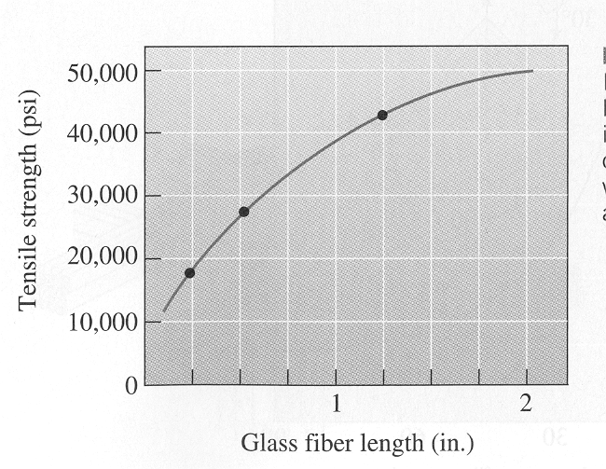
Characteristics of Fiber Reinforced Composites
-As can be seen from this plot, the strength of the composite increases as the fiber length increases (this is a chopped E-glass-epoxy composite)

Slide 74
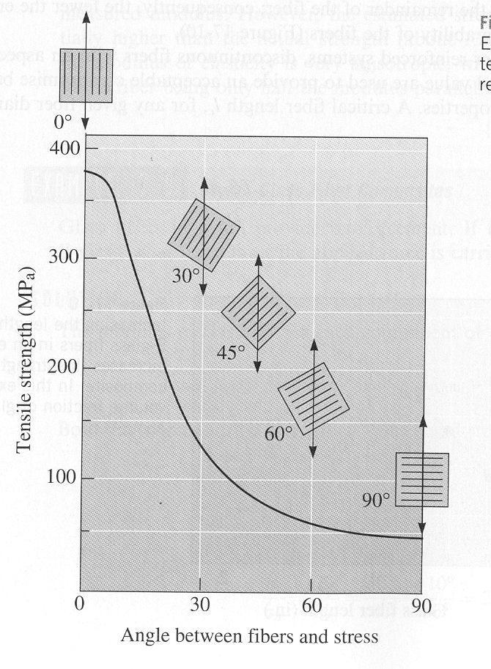
Fiber Orientation
-Maximum strength is obtained when long fibers are oriented parallel to the applied load
-The effect of fiber orientation and strength can be seen in the plot

Slide 75
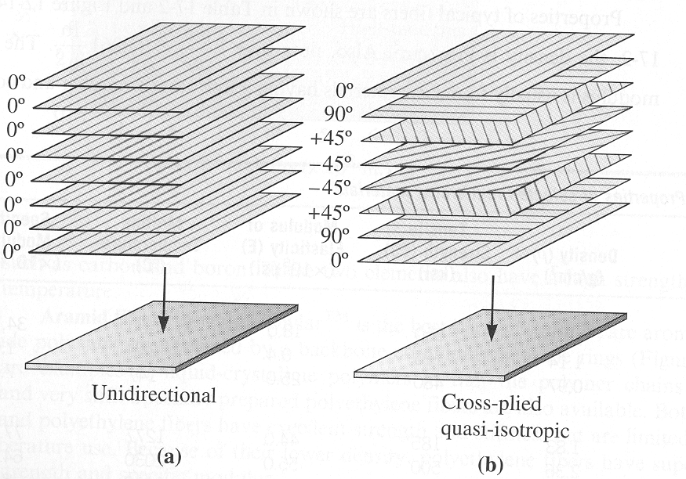
Fiber Orientation
-The properties of fiber composites can be tailored to meet different loading requirements
-By using combinations of different fiber orientation quasi-isotropic materials may be produced
Figure (a) shows a unidirectional arrangement
Figure (b) shows a quasi-isotropic arrangement

Slide 76
Fibers in PMCs
Various forms: discontinuous (chopped), continuous, or woven as a fabric
Principal fiber materials in FRPs are glass, carbon, and Kevlar
Less common fibers include boron, SiC, and Al₂O₃, and steel
Glass is the most common fiber material in today's FRPs; its use to reinforce plastics dates from around 1920

Slide 77
Glass Fibers
-Due to the relatively inexpensive cost, glass fibers are the most commonly used reinforcement
-There are a variety of types of glass, they are all compounds of silica with a variety of metallic oxides
-The most commonly used glass is E-glass, this is the most popular because of it’s cost
Designation: | Property or Characteristic:
E, electrical | low electrical conductivity
S, strength | high strength
C, chemical | high chemical durability
M, modulus | high stiffness
A, alkali | high alkali or soda lime glass
D, dielectric | low dielectric constant

Slide 78
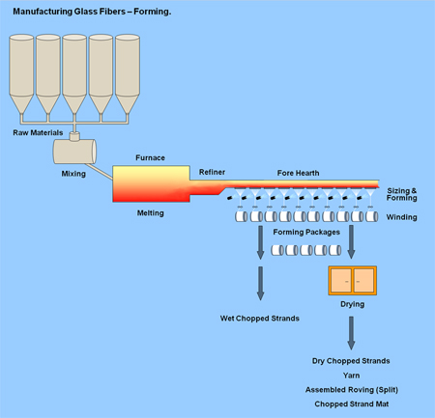
I) Glass fibre reinforced composites
These are prepared by allowing the glass melt through a small and pulling and cooling rapidly which gives a film. The film is glass fibre.
Properties
These are lighter in weight but slightly higher than aramid fibre composites.
High tensile strength
High impact resistances
High chemical inertness
Lower densities
Corrosion resistance
In expensive( Low cost),

Slide 79
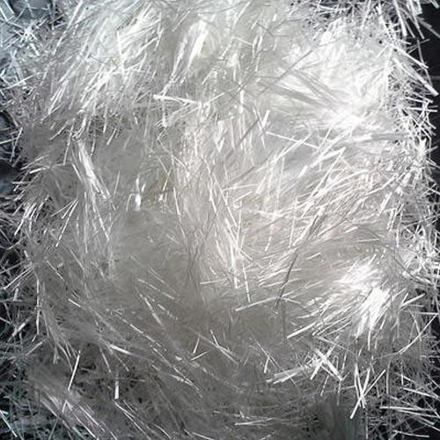


Limitations
Limited working temperature
Do not possess the desired stiffness and rigidity at elevated temperatures.
Applications
Automobile parts
Lining materials for storage tanks
Plastic pipes
Transportation industry to reduce fuel consumption.
loose glass fiber
S – glass FRP
E – glass FRP

Slide 80

Carbon Fibers
-Carbon fibers have gained a lot of popularity in the last two decades due to the price reduction
“Carbon fiber composites are five times stronger than 1020 steel yet five times lighter. In comparison to 6061 aluminum, carbon fiber composites are seven times stronger and two times stiffer yet still 1.5 times lighter”
-Initially used exclusively by the aerospace industry they are becoming more and more common in fields such as automotive, civil infrastructure, and paper production

Slide 81


Slide 82
Carbon based fibre rein forced composites:
These are prepared by carbonisation of high carbon content material at 1000ºC, which gives thread like film known as carbon fibre.
Properties: i) High tensile strength ii) Highly expensive iii) The diameter of C fibre is in the range of 5-10 microns. iv) High specific strength. v) Good resistance to moisture, acids, bases and various solvents. vi) High performance c-fibres are used as dispersed phase in polymer matrix which posses excellent stability to higher temperature, corrosion resistance etc., vii) Lighter in weight.
Limitations: i) Highly expensive, due to the difficulties causes in manufacturing.
Applications: i) Body and stabiliser components of helicopters
ii) Military and commercial aircraft structural components such as wings.
Iii) Due to extreme tensile strength, used as sports and recreational equipments like fishing rods, golf clubs, hockey sticks etc.,

Slide 83
Aramid based fibre rein forced composites:
These are prepared by dissolving aramid polymer in anhydrous H₂SO₄ and the resultant solution is subjected to spinning until a solid thin film is formed. Generally Kevlar is used as aramid fibre.
Properties: i) Ultra-light in weight ii) High tensile strength iii) Moderate expensive iv) Excellent toughness v) Resistance to creep and fatigue failure vi) Stable to higher
temperature vii) Non conducting nature viii) Retain mechanical properties for a wide temperature range (-200 to 200ºC) viii) Much better mechanical properties than steel and metals.
Limitations: i) They are attacked by strong acids and bases ii) Highly sensitive to UV light
Applications: i) Used in automobile brakes, clutches, Ship hulls, Commercial aircrafts like Boeing 767 and Airbus 320 .

Slide 84

LAYERED COMPOSITES
A composite material that consists of two or more layers that are bonded together. Layers in a composite may differ only in structure with the same chemical composition also.
Variety of layered composites with regular structure. a) Plane parallel layers, dt , least translation period in a direction perpendicular to layers; b) undulating (corrugated) parallel layers, dt and lt , translation periods in two directions (X and Y);
c) coaxial layers of equal thickness in a round cylinder;
d) sphere, separated into spherical layers of equal thickness.

Slide 85
FRP Properties
High strength‑to‑weight and modulus‑to‑weight ratios
Low specific gravity - a typical FRP weighs only about 1/5 as much as steel; yet, strength and modulus are comparable in fiber direction
Good fatigue strength
Good corrosion resistance, although polymers are soluble in various chemicals
Low thermal expansion - for many FRPs, leading to good dimensional stability
Significant anisotropy in properties

Slide 86
FRP Applications
Aerospace – much of the structural weight of todays airplanes and helicopters consist of advanced FRPs
Automotive – somebody panels for cars and truck cabs
Continued use of low-carbon sheet steel in cars is evidence of its low cost and ease of processing
Sports and recreation
Fiberglass reinforced plastic has been used for boat hulls since the 1940s
Fishing rods, tennis rackets, golf club shafts, helmets, skis, bows and arrows.

Slide 87
THANK YOU

